Slide 1
Cryptology
Dec 12 2016
GitHub
Trello
Notes:
1

Slide 2
System Diagram
*
JCrypTool
Algorithms
Dialog Box / Visualization

Slide 3
Product Highlights
Provide users with more encryption algorithms, which are candidates for SHA3 in the last round, to choose when using JCrypTool.
Design a better dialog box for users to choose different algorithms and read the output more easily.
Visualized Blake algorithm.

Slide 4
Demonstration

Slide 5
Problem with Algorithms
The algorithm doesn’t output the correct answer.
Test case(for Groestl):
Abcd: D8CD6BE396A8F029BC46E48367D3D84150776C10B7A6AFFEDB19E8D0D175A708
Aefg: D8CD6BE396A8F029BC46E48367D3D84150776C10B7A6AFFEDB19E8D0D175A708
Problem 1: Unless we change the first character of the input, the output will be the same.
Problem 2: Unless we change the length of the input, the output will be the same for most cases.
Problem solved:
Abcd: 4A639E2F274A8B6A4D3AC957456F8FAE8DF80E2AEA89C19276BDACA5586B5F99
Aefg: EDFF182DB0D66874D155CA79CD37FF3F625C822B37AE66E3C1903D50AB5C6C3A

Slide 6
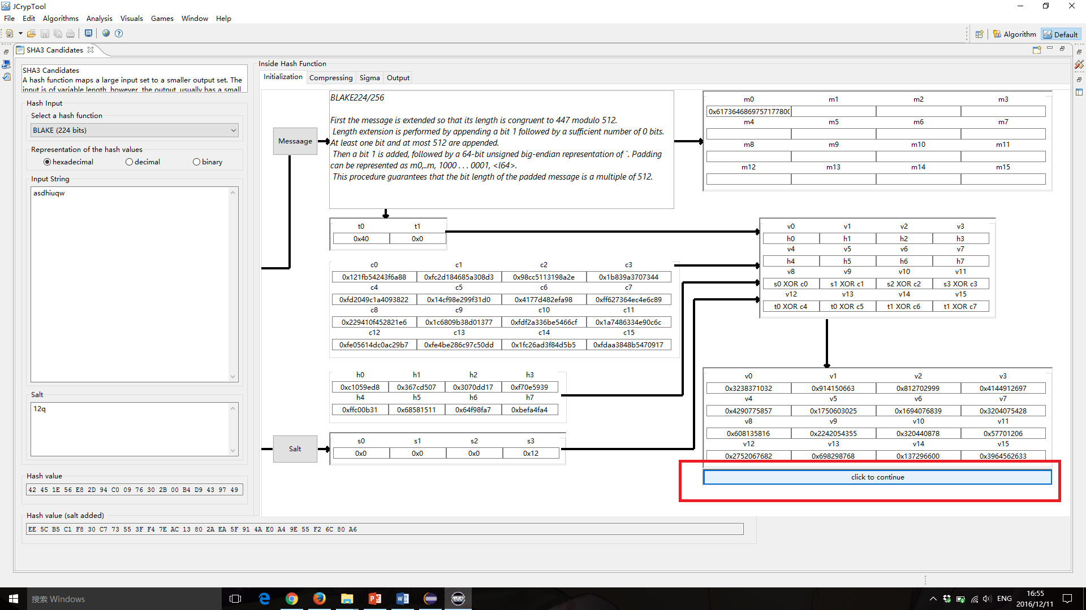
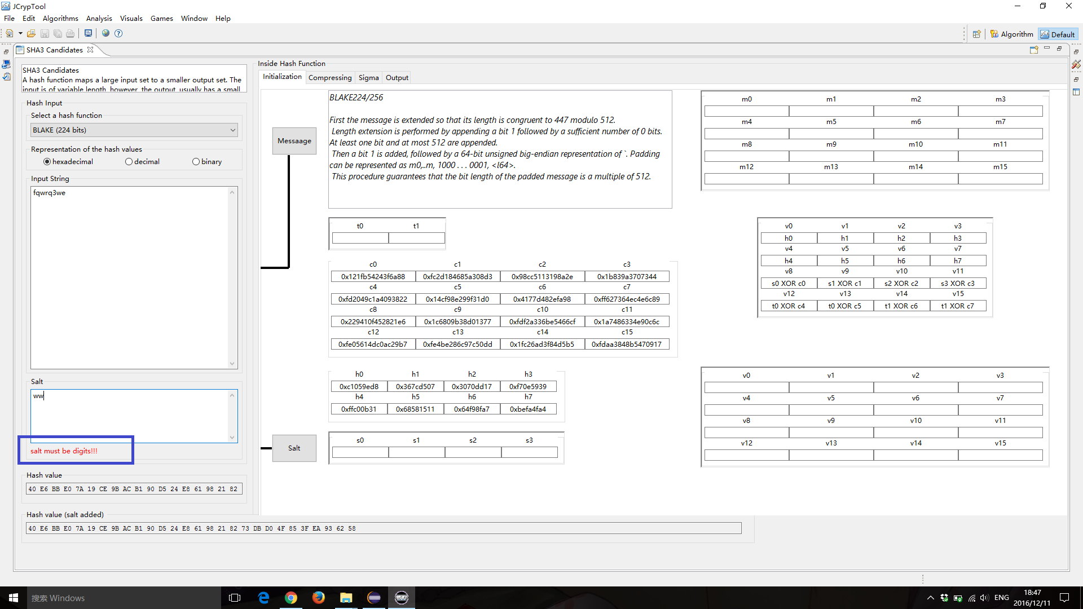
Problem with Visualization
Visualization cannot jump automatically when clicking at the button.
Solved: Input in salt should be a hexadecimal.
Also add alert when input illegal data.

Slide 7
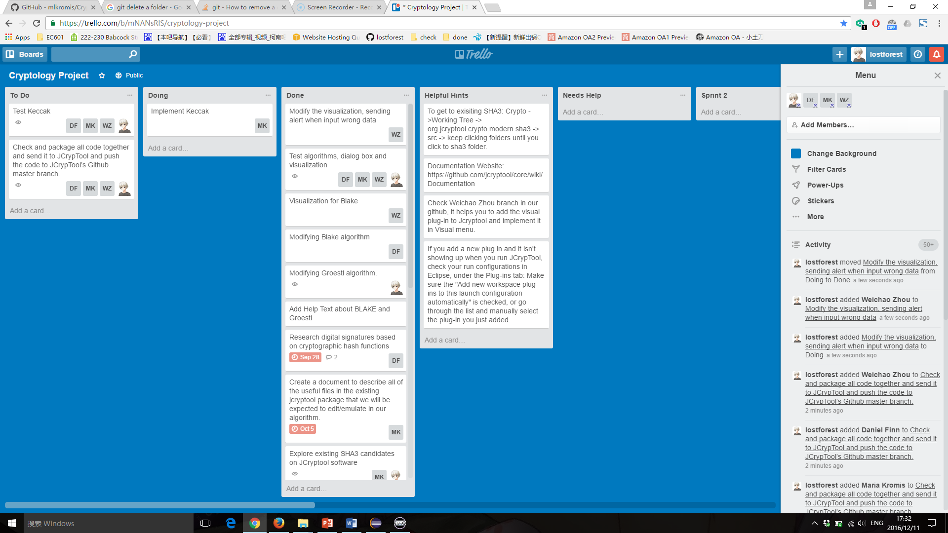
Trello

Slide 8
Test Case 1
1. Different input with same length with 256 hash bit length.
Input1: ABCDefgh
Input2: ABCDijkl

Slide 9
Groestl:
Output1: AA7FF5E8167C47B451C75852A2CF77362708F9D9C15CE349E26D81FB8266B085
Output2:
CE4D4AE59B17F7441F638E519D8A24BE737CDAF9E6A944BF7BF4A609E184A7BF
Blake:
Output1: E6A2B048BAB77FC6798346A34FE91635507DFABF21CF904D63DD12933675C6DB
Output2: 0FFFB62363102F94C5FA4791F565CA93FAD8BE51EC2067E16F2BED91310E8C7B

Slide 10
Test Case 2
2. Different input with only ONE character different
Input1: uihkjllihjkl1oiuhjnkml7liu
Input2: uihkjllihjkd1oiuhjnkml7liu

Slide 11
Groestl:
Output1: EE2BE9B9D85A5F72C11AA258742E1B7E8742C1395966B4CF9D5F66F7780AFA79
Output2: 99FDA91895657FFE1D19F4821945D5750CB9C8F19065F2E413D2EF7A1B904AD4
Blake:
Output1: C054E0ECCC6AD3DE0E539B9F04904C07B6B75ABF528E7A2644F790C4D67B5447
Output2:
42632FE4B23C9C8DCB2C40503D16674EC315DA0BD5EFB1180A985D86D282DF79

Slide 12
Top three things that worked well
Algorithm implementation for SHA3 candidates.
Design the dialog box.
Visualized the Blake algorithm.

Slide 13
Top three things that we have learned
Learn how to develop a plugin based on a project.
Java knowledge, especially the basic Java data structure.
Learn how to use Github, Trello and Slack.

Slide 14
Future plan
Implement SHA3 candidates left.
Build more visualization for SHA3 candidates.
Implement the visualization by import the package other than have a copy for the visualization
Check and package all code together and send it to JCrypTool and push the code to JCrypTool’s Github master branch.

Slide 15
Thank You

